Slide 1
RUBBER PRODUCTS
YAZHINI RUBBERS
(An ISO 9001:2015 certified company)

Slide 2
About Yazhini Rubbers
The vision of the founder, the promoter Mr. A.Seenivasan is to provide employable opportunities to the educated and uneducated youth urged him to improve the concern in all positive ways. The founder’s passion today witnessed the growth of production units in Theni .
The millennium year 2006 envisioned the birth of Yazhini Rubbers for production of various types of rubber products. The production unit at Theni supplies different types of rubber products to the customer.

Slide 3
MISSION VISION
MISSION
Yazhini Rubbers will develop and supply best-in-class, competitive solutions in assemblies to automotive manufacturers, striving to grow in competence and innovativeness, nurturing enduring relationships with our customers and employees, always honoring its corporate citizenship.
VISION
We will grow to be the preferred supplier and solution provider of Industrial & automotive parts , with the largest market share in India. We will double our quality and production output.

Slide 4
SHARE OF BUSINESS

Slide 5
SALES TREND

Slide 6
QUALITY POLICY
We are committed to manufacture and supply of rubber products to the customer satisfaction and to their requirements by continually improving the process through employee team work and achieving through Quality Management System.

Slide 7
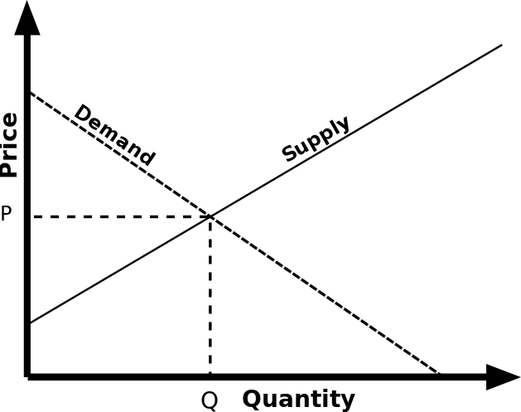
SCHEDULE VS SUPPLY
Schedule

Slide 8
OVER ALL CUSTOMER PPM
TARGET :
100 PPM

Slide 9
INHOUSE PPM

Slide 10
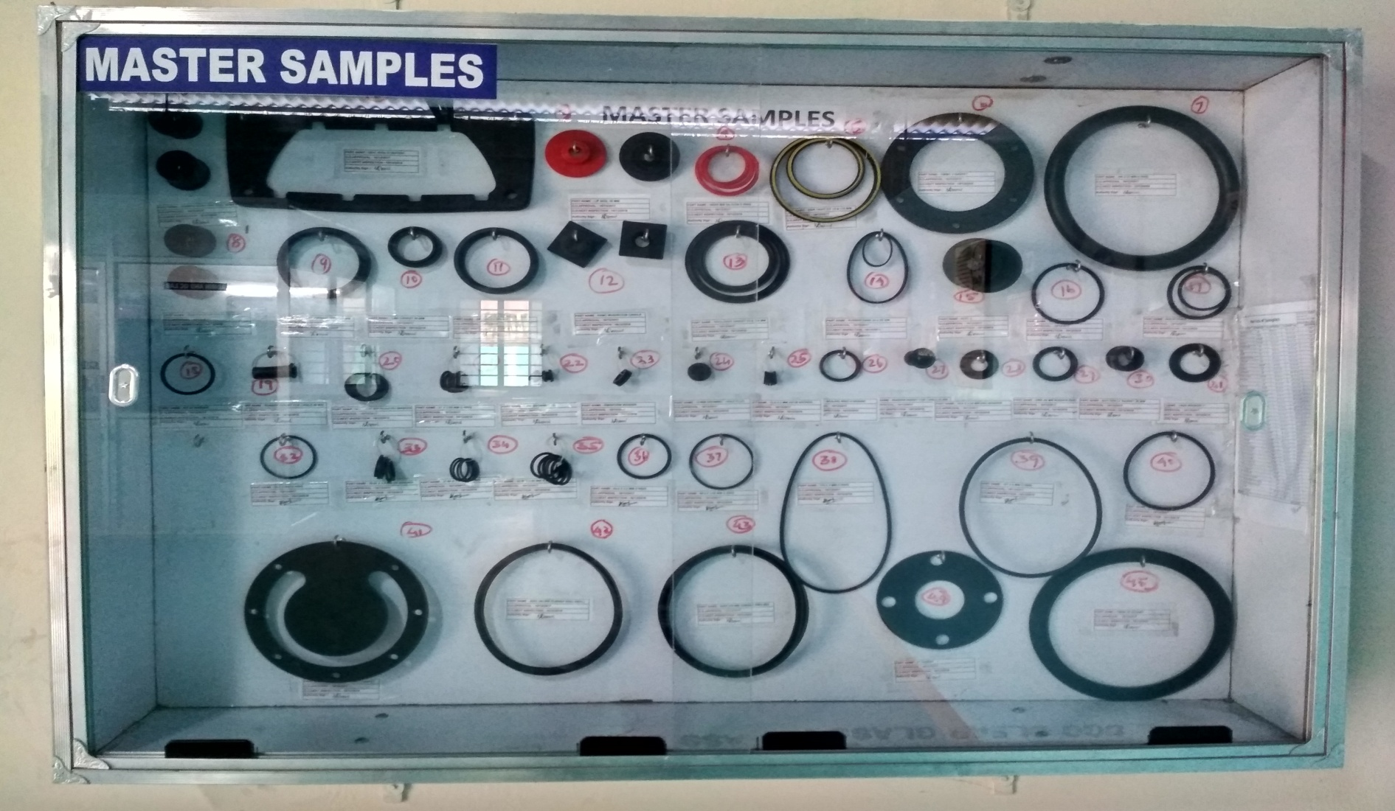
MASTER sAMPLES

Slide 11
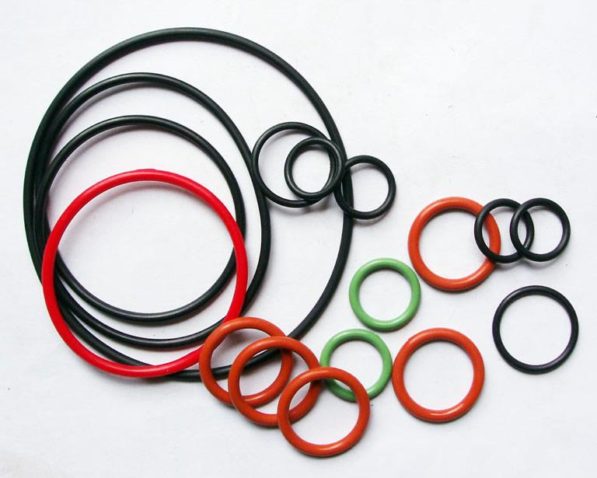
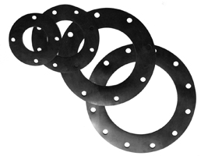
VARIOUS TYPES OF PRODUCTS
O RINGS
GASKETS

Slide 12
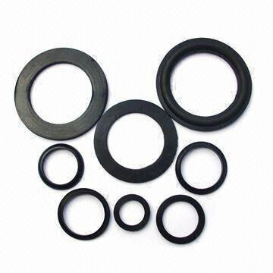
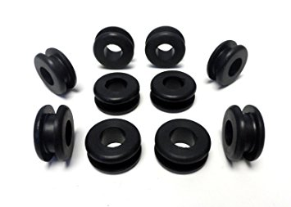
VARIOUS TYPES OF PRODUCTS
WASHERS
GROMMETS

Slide 13
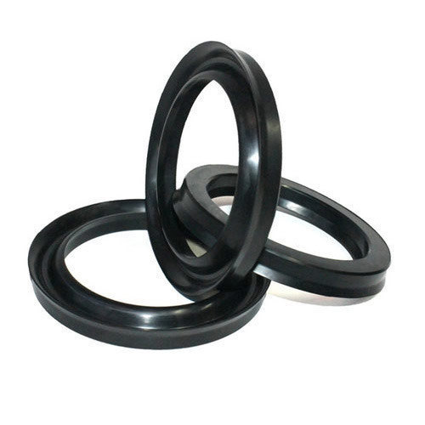
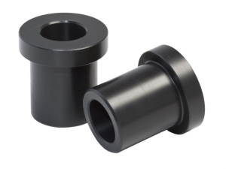
VARIOUS TYPES OF PRODUCTS
BUSHES
SEALS

Slide 14
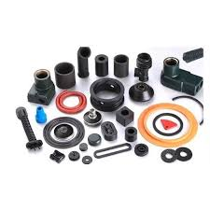
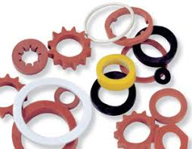
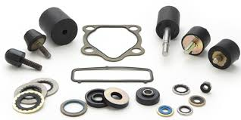
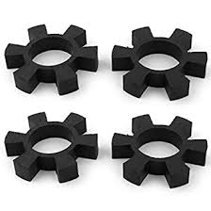
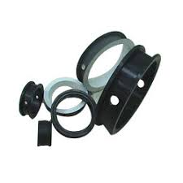
VARIOUS TYPES OF PRODUCTS

Slide 15
OUR CLIENTS IN ALLOVER INDIA

Slide 16
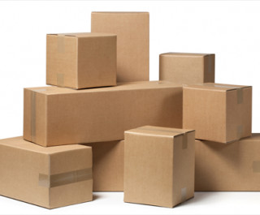
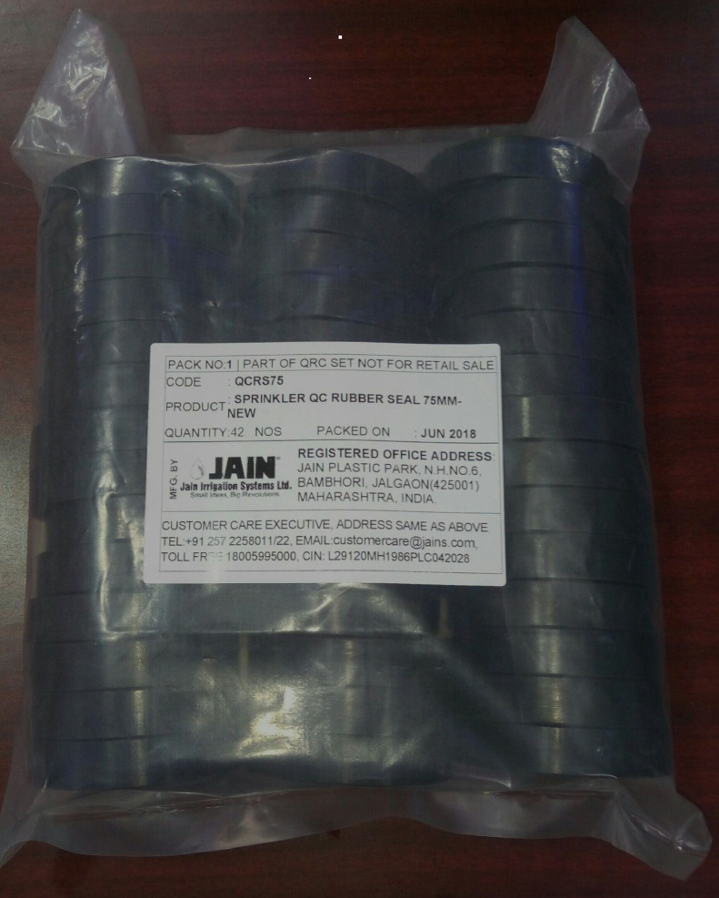
PACKING & STORAGE
PACKING
STORAGE

Slide 17
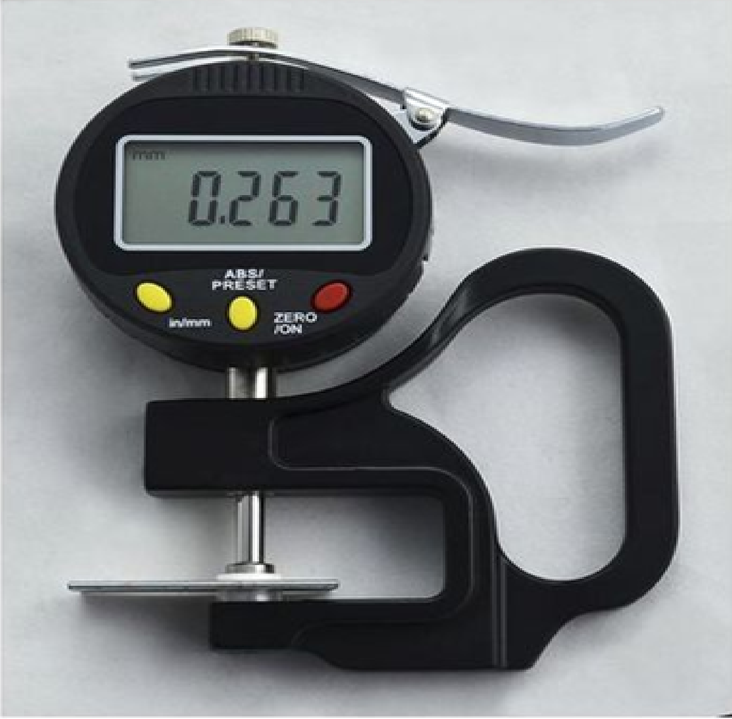
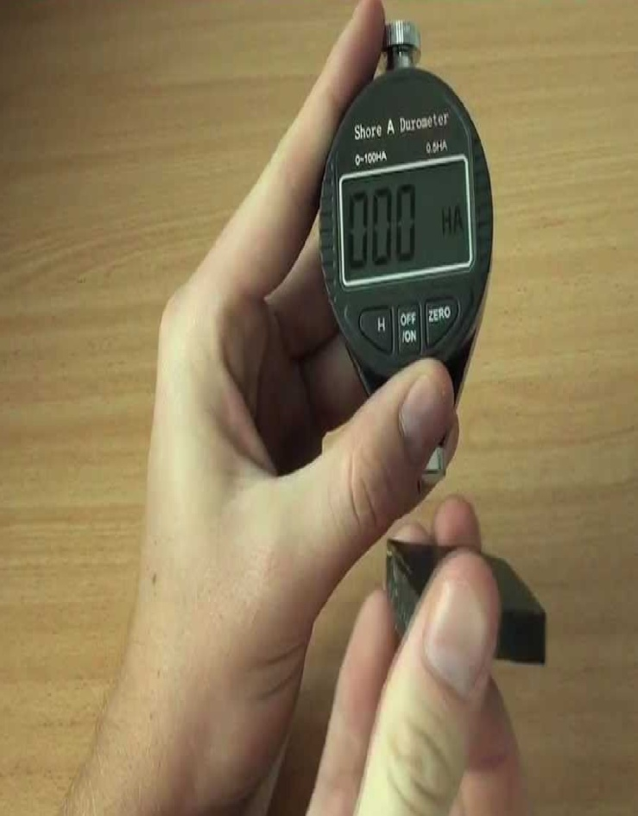
QUALITY

Slide 18
VALUES
Respect: We will value all people, respecting all without bias
Sustainable development: Where it is within our control, we will protect and conserve the natural environment for the benefit of present and future generations.
Ethics: We will maintain transparency, ethics and trust in all our commitments and transactions.
Teamwork: We will promote the spirit of team work, recognizing the value of both the business and the individual
Integrity: We will promote the culture where the people honor the alignment of thought, word and deed.

Slide 19
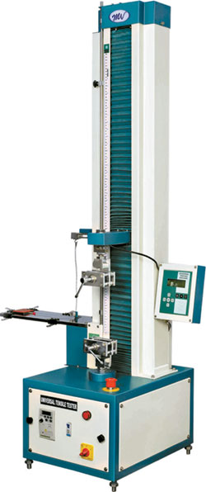
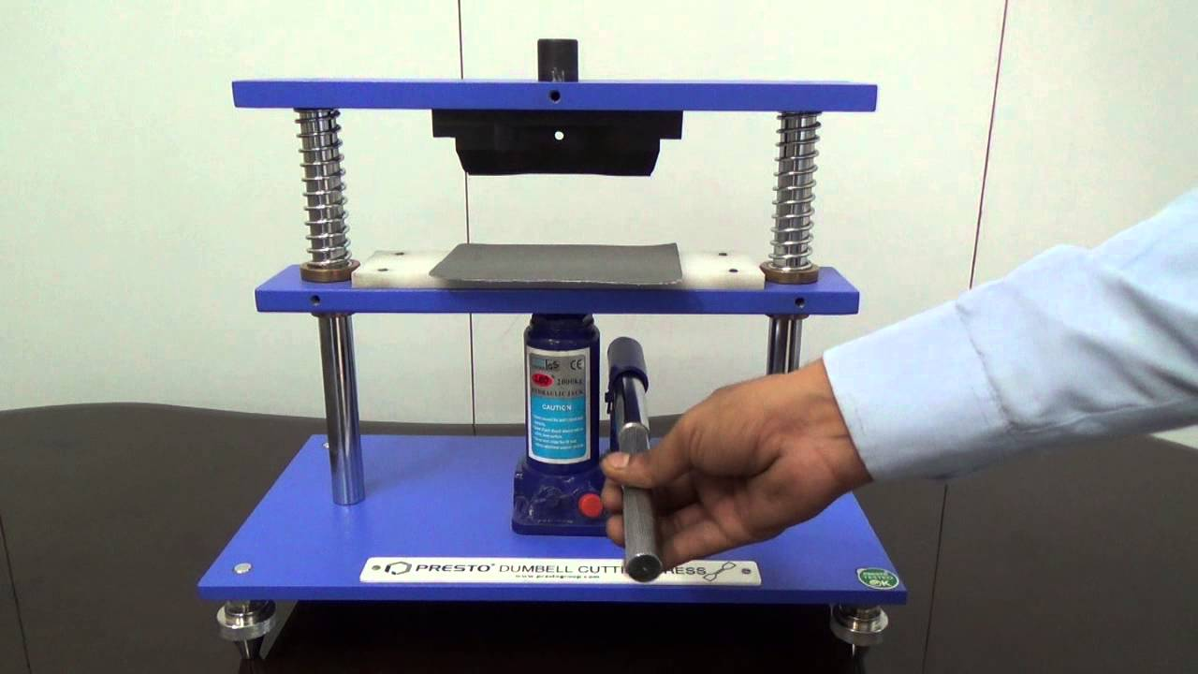
MACHINERIES
DUMBELL CUTTING MACHINE
TENSILE TESTING MACHINE

Slide 20
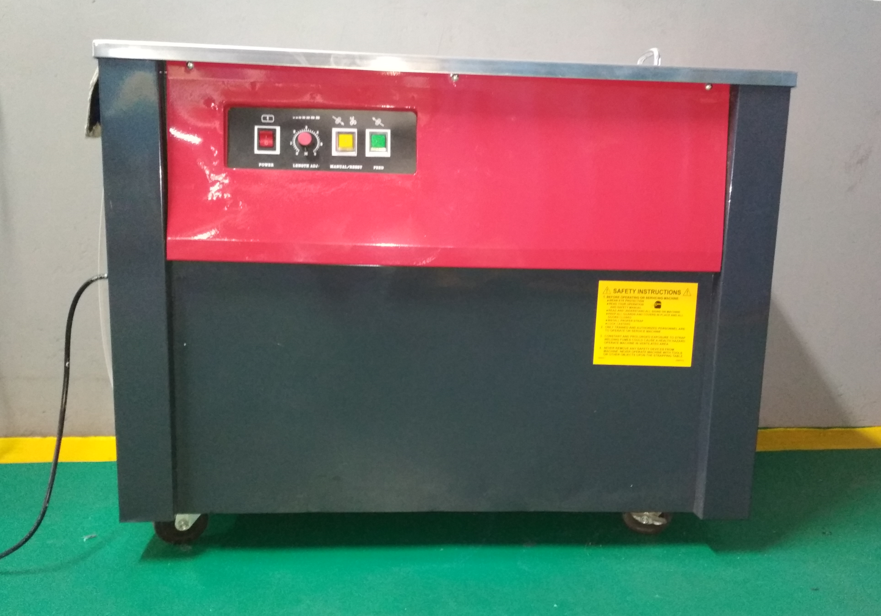
MACHINERIES
BOX STRAPPING MACHINE

Slide 21
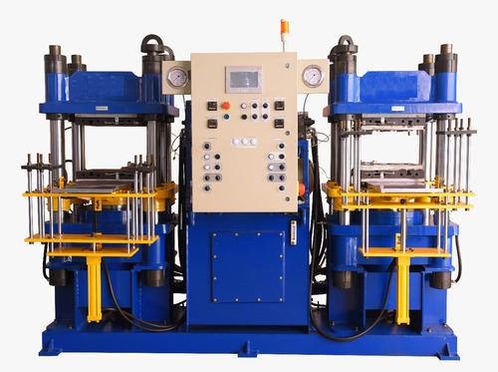
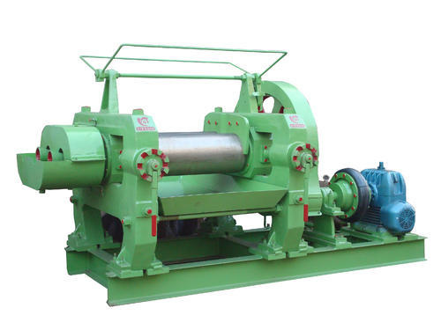
MACHINERIES
MIXING MACHINE:
CAPACITY : 12” X 36” – 30 HP
MOULDING PRESS:
CAPACITY : 80-150 TONNES

Slide 22
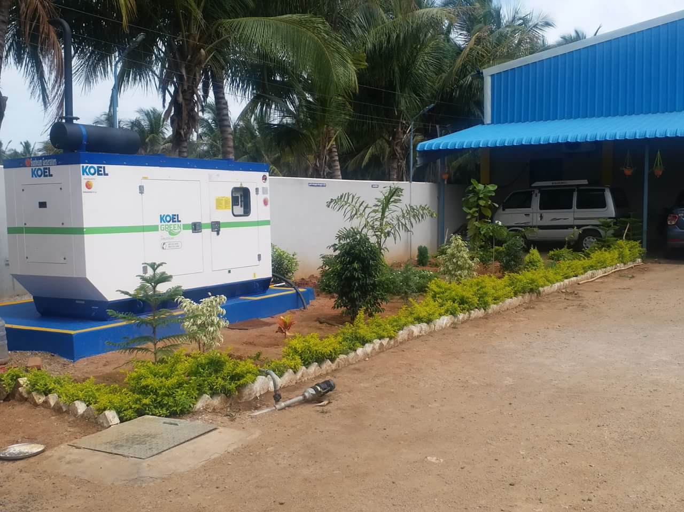
POWER BACK UP FACILITIES

Slide 23
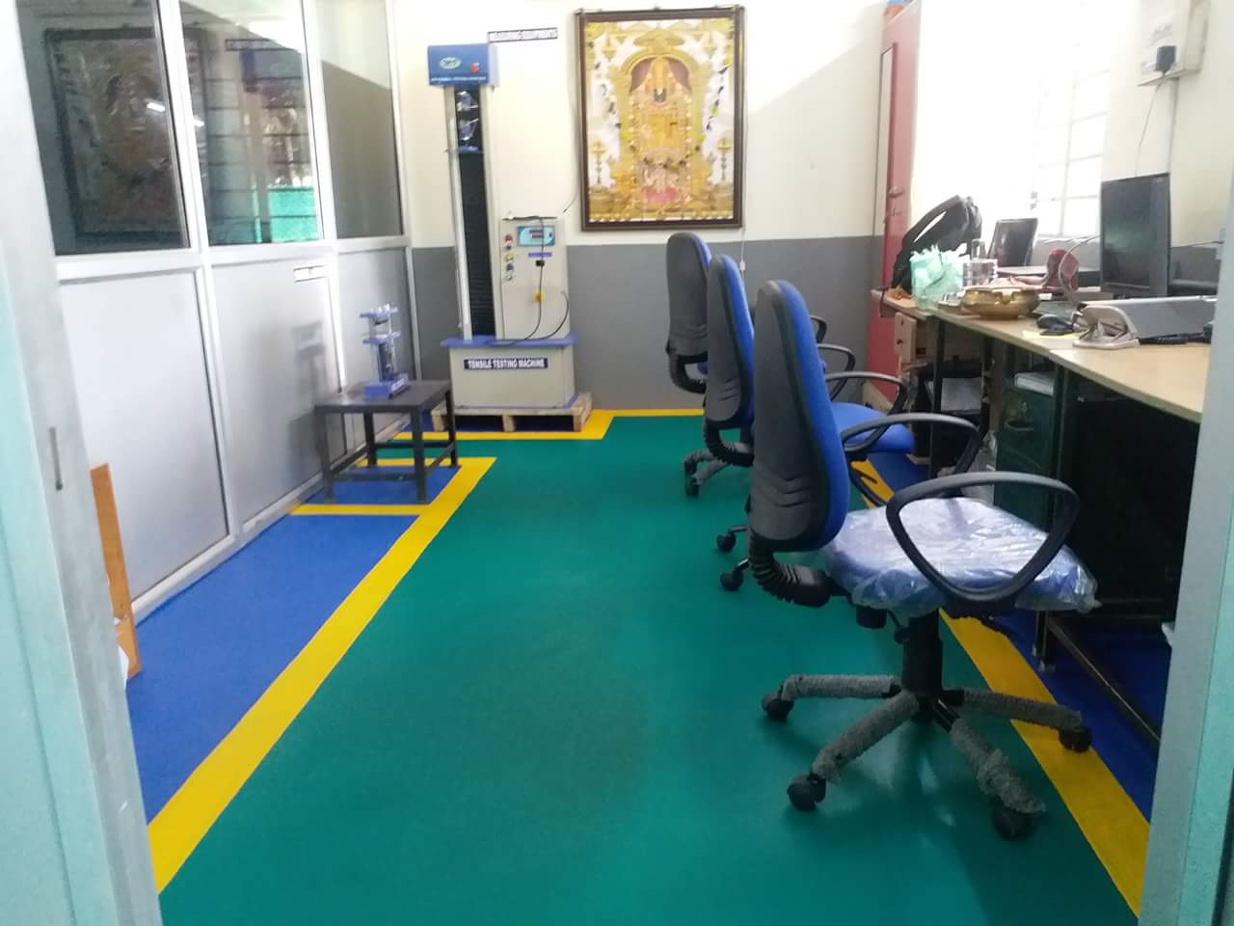
LAB FACILITIES

Slide 24
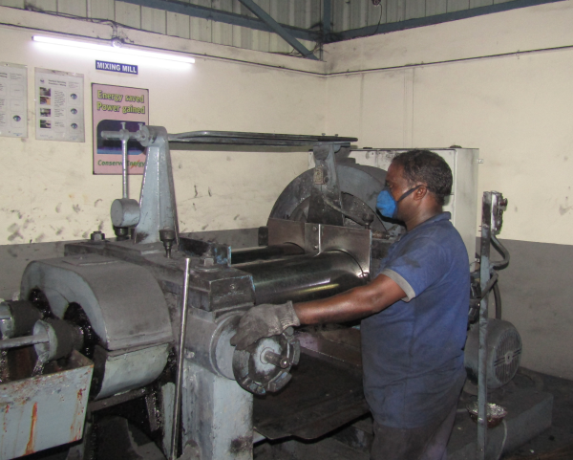
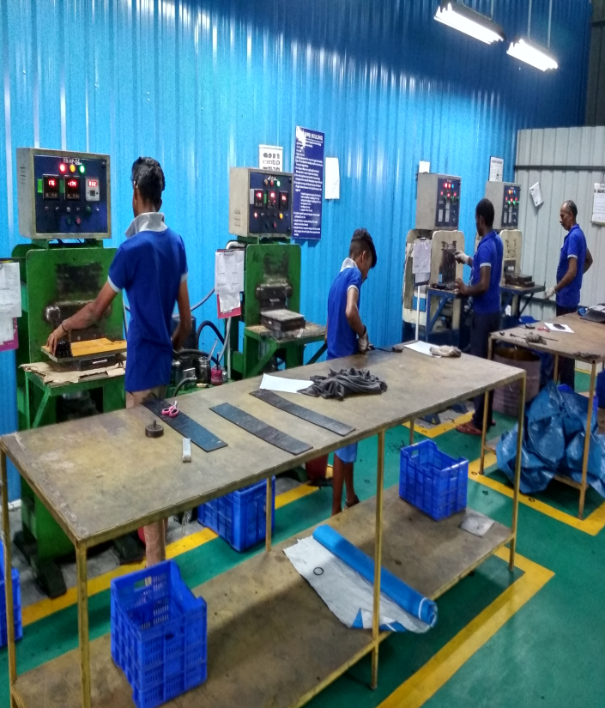
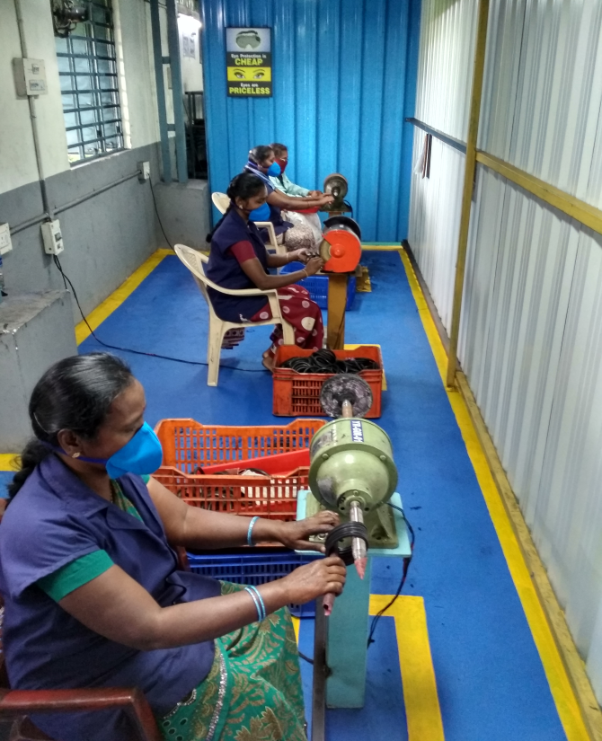
PRODUCTION FACILITIES

Slide 25
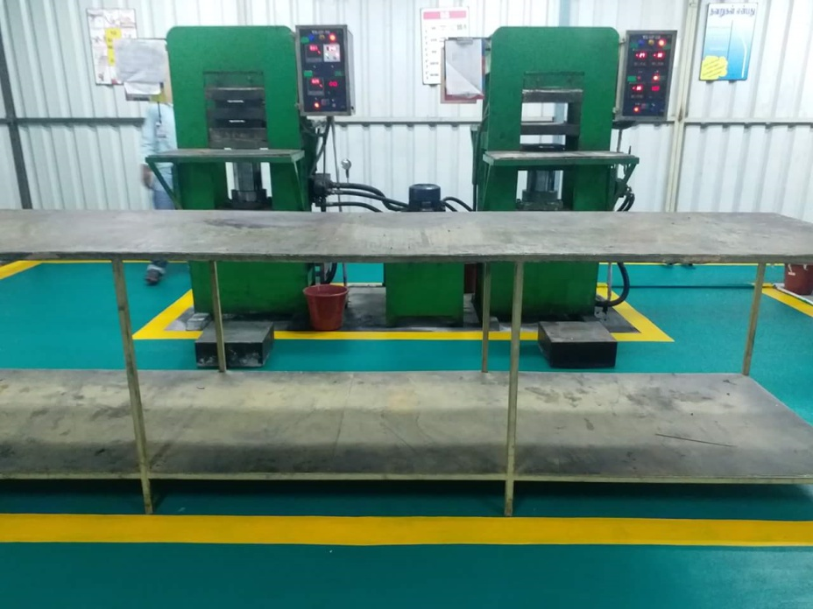
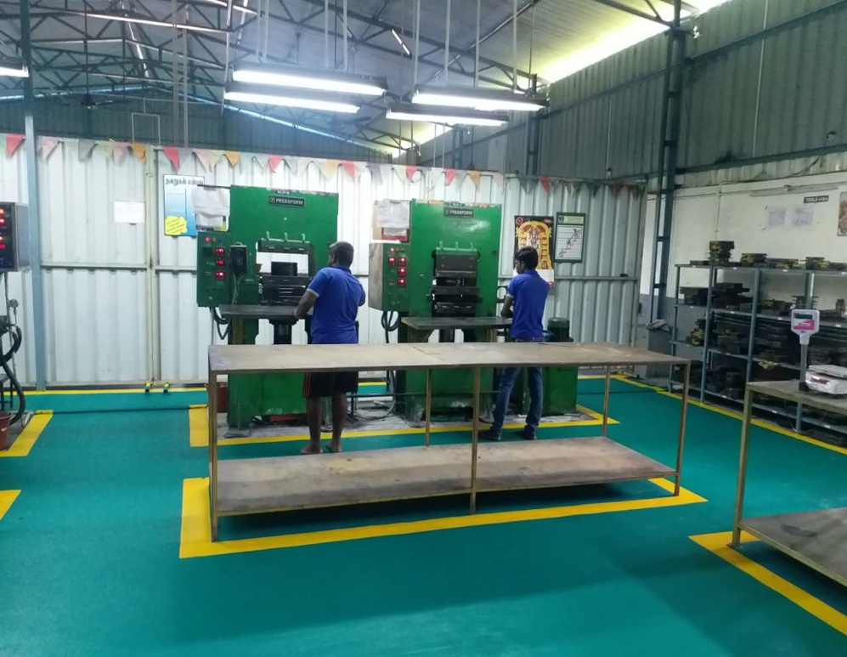
PRODUCTION FACILITIES

Slide 26
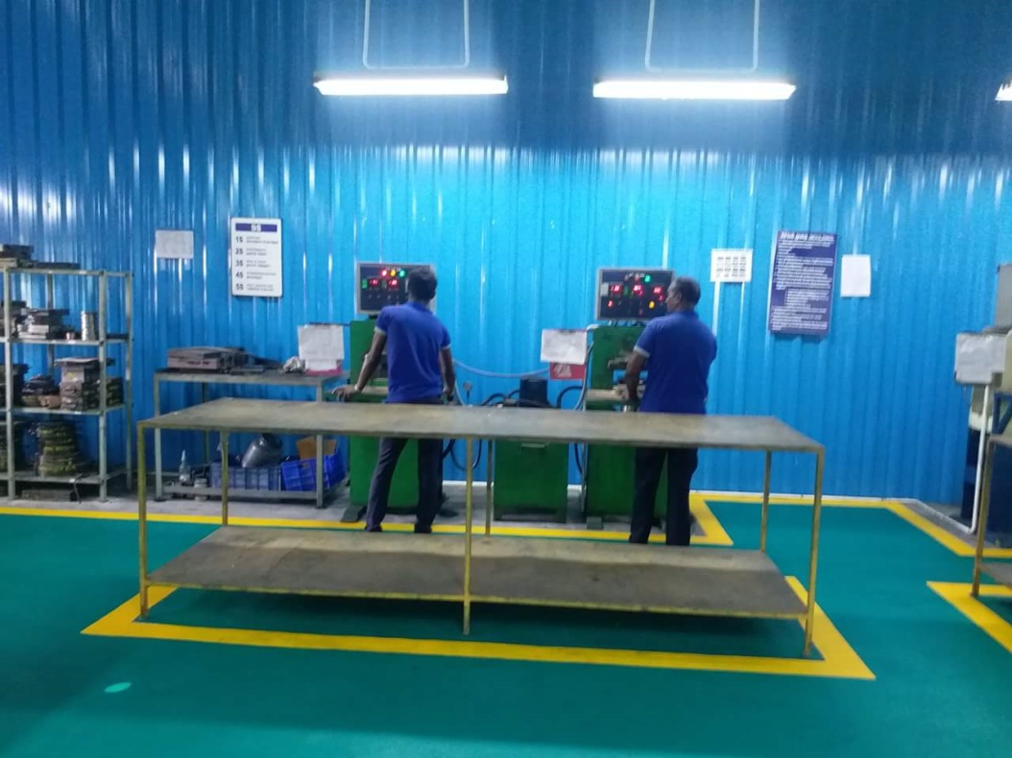
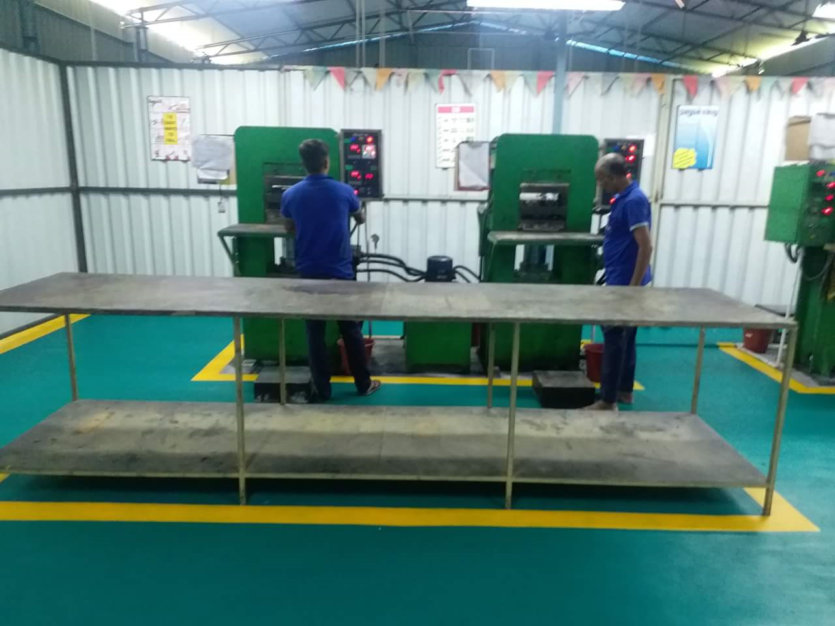
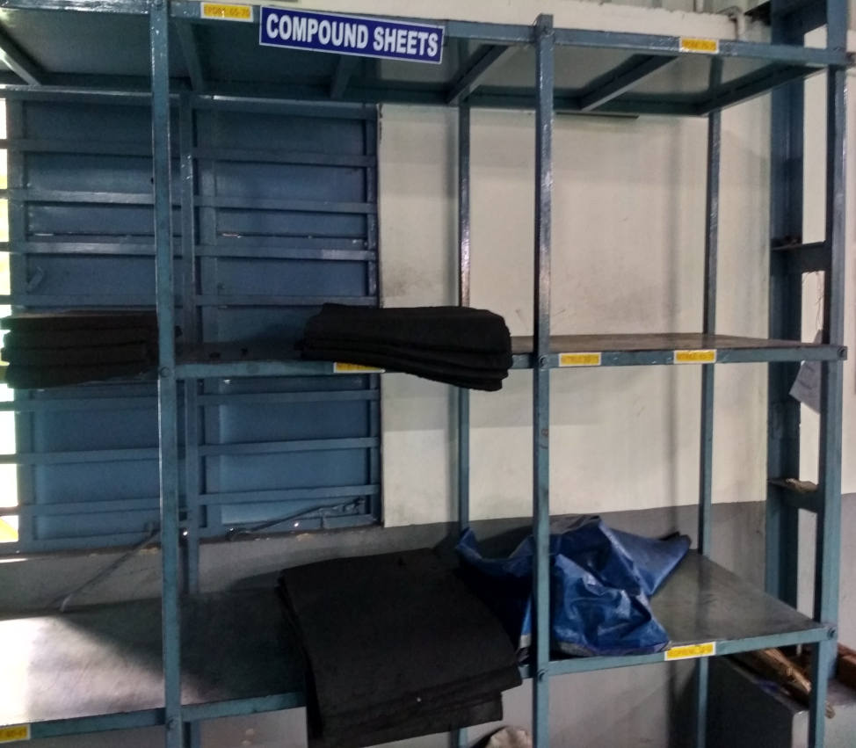
PRODUCTION FACILITIES

Slide 27
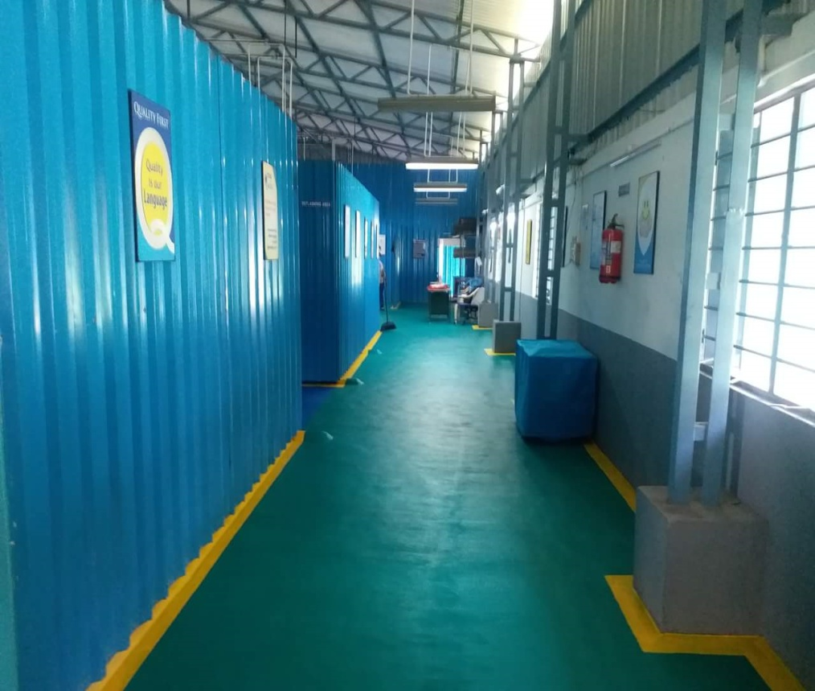
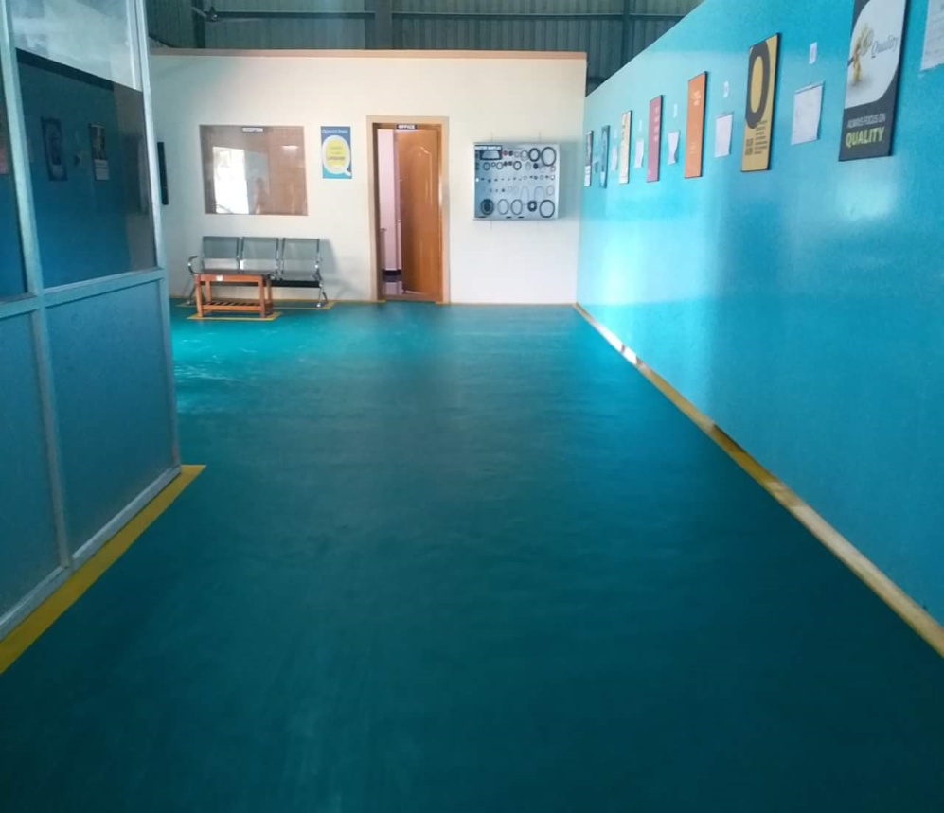
HOUSE KEEPING FACILITIES

Slide 28
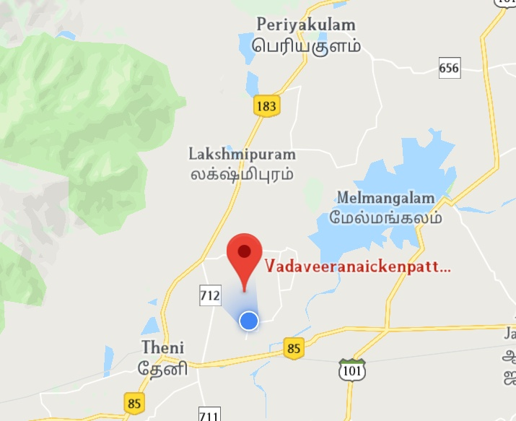
LOCATION
YAZHINI RUBBERS,
Plot No: 1076/1, Karuvelnayakkanpatti,
Vadaveeranayakkanpatti- Village,
Theni, Tamilnadu – 625531.
Ph: 04546-294541,
Mob: 098421-38866,094428-38829
E-mail: yazhinirubbers@gmail.com
Website: www.yazhinirubbers.net

Slide 29
THANK YOU

